Slide 1
Access Control

Slide 2
Introduction
“Access control” is where security engineering meets computer science.
Its function is to control which (active) subject have access to a which (passive) object with some specific access operation.
subject
Access
Operation
object
Figure I. Access Control Model

Slide 3
Introduction
Access Controls: The security features that control how users and systems communicate and interact with one another.
Access: The flow of information between subject and object
Subject: An active entity that requests access to an object or the data in an object
Object: A passive entity that contains information

Slide 4
Security Principles
The three main security principles also pertain to access control:
Availability
Integrity
Confidentiality

Slide 5
Identification, Authentication, and Authorization
Identification, Authentication, and Authorization are distinct functions.
Identification
Authentication
Authorization
Identity Management: A broad term to include the use of different products to identify, authenticate, and authorize users through automated means

Slide 6
Identification
Method of establishing the subject’s identity
User, Program, Process
Use of username or other public information
Identification component requirements
Each value should be unique
Follow a standard naming scheme
Non-descriptive of the user’s position or tasks
Must not be shared between users

Slide 7
Authentication
Method of proving the identity
Something you know (Passwords, OTP, Passphrase)
Something you have (Smart Card, Token, Document)
Something you are (Fingerprints, Retina Scan)
Use of passwords, token, or biometrics other private information
What is two factor authentication?
Strong authentication

Slide 8
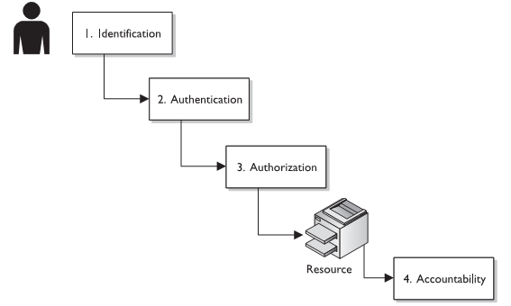
Authorization
Figure II. Authorization Mechanism

Slide 9
Types of Access Controls
Administrative controls
Define roles, responsibilities, policies, and administrative functions to manage the control environment.
Technical controls
Use hardware and software technology to implement access control.
Physical controls
Ensure safety and security of the physical environment.

Slide 10
Administrative controls
Policies and procedures
Security awareness training
Asset classification and control
Employment policies and practices (background checks, job rotations, and separation of duties)
Account administration
Account, log monitoring
Review of audit trails

Slide 11
Technical controls
Encryption
Biometrics
Smart cards
Tokens
Access control lists
Violation reports
Audit trails
Network monitoring and intrusion detection

Slide 12
Physical controls
HVAC
Fences, locked doors, and restricted areas
Guards and dogs
Motion detectors
Video cameras
Fire detectors
Smoke detectors

Slide 13
Categories of Access Controls
Control Type | Description
Preventive | Avoid incident
Deterrent | Discourage incident
Detective | Identify incident
Corrective | Remedy circumstance/mitigate damage and restore controls
Recovery | Restore conditions to normal
Compensating | Alternative control

Slide 14
Access Control Threats
Insiders
Countermeasures include good policies and procedures, separation of duties, job rotation
Dictionary Attacks
Countermeasures include strong password policies, strong authentication, intrusion detection and prevention
Brute Force Attacks
Countermeasures include penetration testing, minimum necessary information provided, monitoring, intrusion detection, clipping levels
Spoofing at Logon
Countermeasures include a guaranteed trusted path, security awareness to be aware of phishing scams, SSL connection

Slide 15
Access Control Monitoring
Intrusion Detection Systems
Network Based (NIDS)
Host Based (HIDS)
HIDS and NIDS can be:
Signature Based
Statistical Anomaly Based
Protocol Anomaly Based
Traffic Anomaly Based
Rule Based

Slide 16
Access Control Monitoring
Intrusion Prevention Systems
Preventative and proactive technology, IDS is a detective technology.
Network Based (NIPS)
Host Based (HIPS)
Honeypots
An attractive offering that hopes to lure attackers away from critical systems
Network sniffers
A general term for programs or devices that are able to examine traffic on a LAN segment.

Slide 17
Access Control Models
Organizations use access control mechanisms to mitigate the risks of unauthorized access to their data, resources, and systems. Several access control models exist.
In some cases, the more complicated models expand upon and enhance earlier models, while in other cases they represent a rethinking of the fundamental manner in which access control should be done.
In many cases, the newer, more complicated models arose not from deficiencies in the security that earlier models provide, but from the need for new models to address changes in organizational structures, technologies, organizational needs, technical capabilities, and/or organizational relationships.

Slide 18
Access Control Models
RAdAC
Increasing Policy Basis for Access Control Decision
PBAC
ACL
RBAC
ABAC
Increasingly Finer Granularity of Access Control

Slide 19
Access Control Lists (ACL)
The concept of an ACL is very simple: each resource on a system to which access should be controlled, referred to as an object, has its own associated list of mappings between the set of entities requesting access to the resource and the set of actions that each entity can take on the resource.
Some applications also maintain access control lists to determine which users are able to view certain data elements.

Slide 20
Access Control List (ACL)
Matrix is stored by column.
Each object is associated with a list
Indicate for each subject the actions that the subject can exercise on the object

Slide 21
Access Control Lists: Limitations
The ACL for a particular file, process, or other resource must be checked every time the resource is accessed, and this can be an inefficient means of providing access control.
ACLs control not only user access to system resources; they also control application and system access as well.
ACLs can also be difficult to manage in an enterprise setting where many people need to have different levels of access to many different resources.
Selectively adding, deleting and changing ACLs on individual files, or even groups of files, can be time-consuming and error-prone.

Slide 22
Role-based Access Control (RBAC)
RBAC determines access based on roles.
More than one person can have the same role.
RBAC allows for the grouping of individuals into categories of people who fulfill a particular role.
One set of access control permissions on a particular resource.
The source code tree for a new piece of software can be set once for all members of the software engineering department.

Slide 23
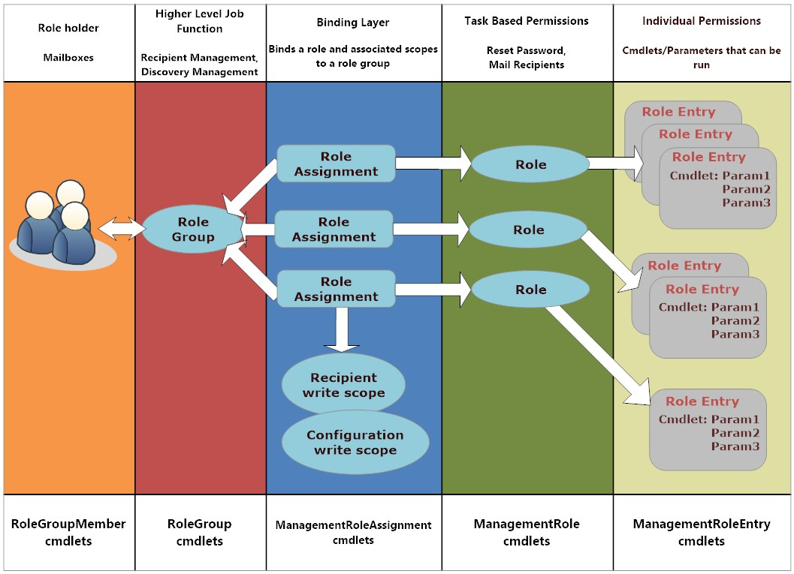
Role-based Access Control (RBAC)

Slide 24
Role-based Access Control: Limitations
One of the most significant is the fact that dividing people into categories based on roles makes it more difficult to define granular access controls for each person.
It is often necessary to create more specific versions of roles or devise other mechanisms to exclude specific individuals who fall into a particular role, but do not necessarily need to have the full rights accorded to other members of a group.

Slide 25
Attribute Based Access Control (ABAC)
Access control decisions are made based on a set of characteristics, or attributes.
Associated with the requester, the environment, and/or the resource itself.
Each attribute is a discrete, distinct field that a policy decision point can compare against a set of values to determine whether or not to allow or deny access.
Attributes do not necessarily need to be related to each other.
A
ttributes that go into making a decision can come from disparate, unrelated sources.

Slide 26
Attribute Based Access Control: Limitations
One limitation of the ABAC model is that in a large environment with many resources, individuals, and applications, there can be disparate attributes and access control mechanisms among the organizational units.
It is often necessary to harmonize access control across the enterprise in order to meet enterprise governance requirements.

Slide 27
Policy-based Access Control (PBAC)
Emerging model that seeks to help enterprises address the need to implement concrete access controls based on abstract policy and governance requirements.
PBAC can be said to be a harmonization and standardization of the ABAC model at an enterprise level in support of specific governance objectives.
PBAC combines attributes from the resource, the environment, and the requester with information on the particular set of circumstances under which the access request is made
It uses rule sets that specify whether the access is allowed under organizational policy for those attributes under those circumstances.

Slide 28
Policy-based Access Control: Limitations
In contrast to the other access control models, PBAC requires not only complicated application-level logic to determine access based on attributes, but also a mechanism to specify policy rules in unambiguous terms.

Slide 29
Risk-Adaptive Access Control (RAdAC)
Devised to bring real-time, adaptable, risk-aware access control to the enterprise.
RAdAC represents a fundamental shift in the way access control is managed.
It extends upon other earlier access control models by introducing environmental conditions and risk levels into the access control decision process.

Slide 30
Risk-Adaptive Access Control: Limitations
RAdAC faces a variety of non-technical challenges, including those of policy and law:
Does deploying RAdAC in certain environments violate the law?
Who is accountable if a security breach were to occur?
Are the system owners, the RAdAC implementers and administrators, and/or the RAdAC system designers ultimately responsible if a breach were to occur?

Slide 31
Conclusion
The business-to-business (B2B) relationships that enable organizations to successfully execute their missions, for example, sometimes require users or systems from one business to access resources from business partners.
Simpler access control models often cannot adequately meet the complex access control requirements that such relationships require, and so more granular, powerful, dynamic models and mechanisms are needed to address these new realities.
In short, increasingly complex data access and sharing requirements drive the need for increasingly complex access control models and mechanisms.

Slide 32
References
[1] | R. Sandhu and P Samarati. Access control: Principles and practice. IEEE Communications MAGAZINE, 32-9X40-48, 1994
[2] | NIST, “A Survey of Access Control Models” Pdf available at: http://csrc.nist.gov/news_events/privilege-management-workshop/PvM-Model-Survey-Aug26-2009.pdf, Last accessed : August 2016.
[3] | Muhammad Wajahat Rajab, “Access Control”, Available at: http://www.slideshare.net/wajraj/access-control-presentation-23717821, Last accessed : August 2016.
[4] | EECS, “Access Control ”, Available http://www.web.eecs.umich.edu/~aprakash/security/handouts/ AccessModel_040112_v2.ppt, Last accessed : August 2016.

